Slide 1
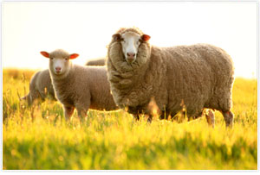
2019년도 1학기 환경과 영양
Nutrient requirement of small ruminants
(Environmental impact)
2019. 3. 20. (수)
사료생물공학 실험실
이우도

Slide 2
목차
CONTENTS
01 Small ruminant
02 Benefits of small ruminant use in foraging systems
and range restoration
03 Concerns

Slide 3
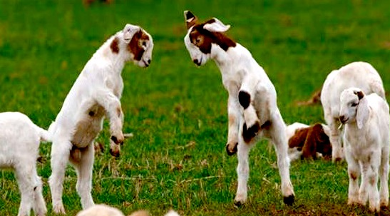
Small ruminant
Small ruminant (소형 반추동물)
: such as sheep and goats, cervid etc.
: meat, milk and fiber products, in addition to other uses such as weed control and livestock shows.
Small ruminants : mainly for four functions
(1) Meat (2) Milk (3) Skin (4) Wool
FAO (1982) : tropical Africa has
- Sheep : one-sixth / goat : a third of the world
- Meat produced (small ruminant)
: 1.3 million metric tonnes (16% of the world)

Slide 4
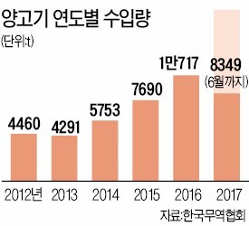
Small ruminant
Sheep
: lives in various environments (mainly dry places)
: herbivorous and good digestive power
-> vegetable (grass, fruit, leaves, and bark)
-> At one time, a large amount of grass is eaten and rested (ruminate)
-> consumed in vegetable food consisting only of cellulose and starch
The sheep females are determined by day length.
: pregnant -> early fall to midwinter
: menstrual cycle is 14 to 20 days (17 days)
: In a sheep farm
-> 25 to 35 females are mated per male
: length of gestation -> 148 days
(birth to one or two offspring in spring)
: Newborn babies can walk straight away
and mature sexually in the first year of life.

Slide 5
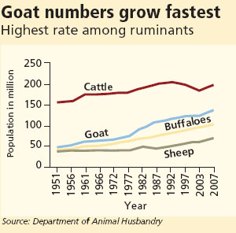
Small ruminant
Goat
: eat leaves well -> leaves of shrubs / climb high branches of trees and eat leaves
-> devastate the land
: breeding season -> autumn (21-day cycle / 12 months or older : generally mate)
: gestation period is about 152 days and gives birth in early spring.
: offspring usually produce one, but often have two or three.
Wild goats adapt well to all environments (mostly live in mountain)
: Eating bark, leaf, tree bark etc.
: Most species of wild goats live in Asia
The life span : 10 to 16 years
: sexual maturity -> 5-6 months after

Slide 6
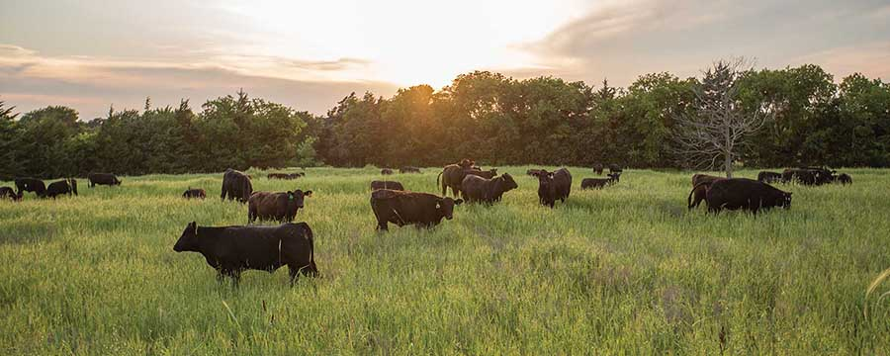
Benefits of small ruminant use in foraging systems and range restoration
When rangeland grazing/foraging is left unbalanced (maintaining cow or horse)
: overgrazing / desertification / noxious weed / woody plant overgrowth will occur
-> requires the ability to balance plant growth and plant harvesting.
Multispecies grazing (Heitschmidt et al., 2004)
-> effectively alter the amounts of usable plant material to a more harvestable biomass.
-> debarking, defoliation habits of goats : alter the viability of many species of woody brush.

Slide 7
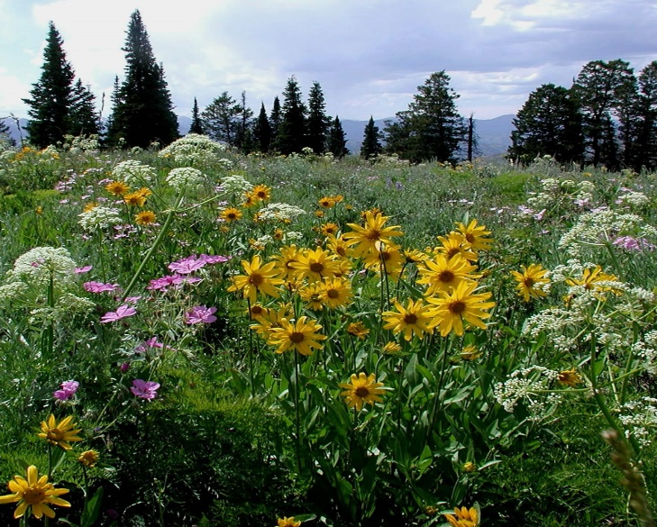
Benefits of small ruminant use in foraging systems and range restoration
Villalba et al. (2002)
: Including goats in a forage harvesting system with sheep, cattle, and/or horses
-> low-cost, environmentally friendly method of increasing income,
improving range sustain ability.
Hart (2001) : Sheep will reportedly consume diets of 15 percent forbs and 31 percent browse, whereas goats prefer diets high in browse (70 percent) and forbs (10 percent)
forb

Slide 8
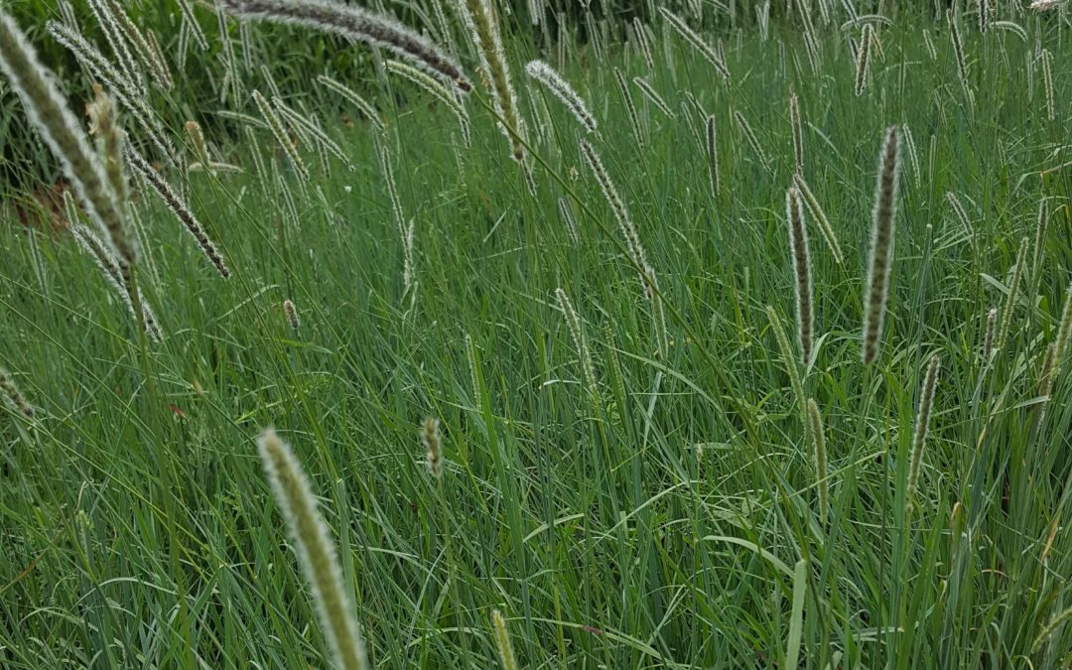
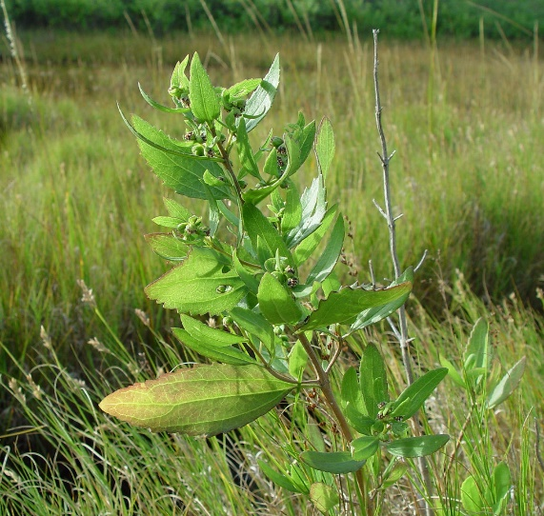
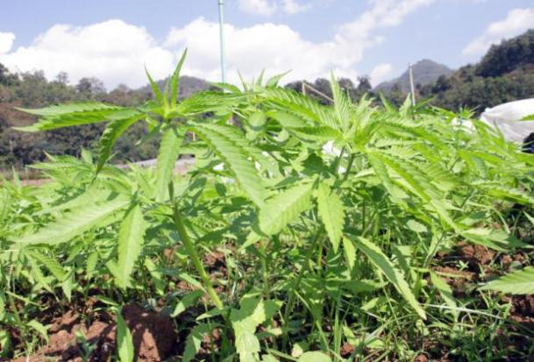
Benefits of small ruminant use in foraging systems and range restoration
Goats : consume plant species not utilized by other species (Taylor, 1985).
-> very useful in the control of woody plants, weeds, and brush (depress range productivity)
ex) leafy spurge, Sericea lespedeza, post oak, black jack, black locust, shinnery oak, thistle, sumac, poison ivy, multiflora rose, eastern red cedar, iron weed, sumac, sweet briar, green briar, brambles, and honeysuckle.
-> benefit to the primary purpose of range management to produce meat and fiber
Brush
Woody plants
Weed

Slide 9
Benefits of small ruminant use in foraging systems and range restoration
Used small ruminants (with cattle) : reduce the added production costs of chemical / mechanical control of weeds and increase in biomass of harvested livestock
Many woody plants : have extensive root systems allowing them to become well established and to sequester soil nutrients -> not readily eaten by cattle or horses
In addition, goats can aid in the reestablishment of grassy species in some overgrazed and eroded range conditions by consuming and, thus, recycling nutrients held in the weeds (Hart, 2001).
-> increase available soil nitrogen, phosphorus, and potassium (Escobar et al, 1998).
-> help to minimize erosion, while maximizing grassland restoration.
Supplemental feeding can be valuable in the promotion of more uniform grazing, particularly in underused areas (Bailey, 2004).
The "moving" of the flock or herd can help to redistribute some nutrients (e.g., phosphates)

Slide 10
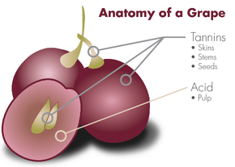
Benefits of small ruminant use in foraging systems and range restoration
Co-grazing of small ruminants, horses, and cattle will reduce
: parasitism of anyone animal species / animal losses to poisonous plants
(Taylor and Ralphse, 1992; Hart, 2001; Hoste et al., 2001).
Sheep & goats : benefit of tannin-rich ingestion
-> consume and control tannin rich vegetation (Villalba et al., (2002))
: potential reduction in internal parasites / reduced incidence of bloat / improvement of
other health conditions (Hart, 2001; Waghorn and McNabb, 2003).
-> reduce the spread of weeds and woody plant (Fay, 1991; Mayo, 2000)
-> reduce brush overgrowth for the improvement of wildlife habitats (Hart, 2001).

Slide 11
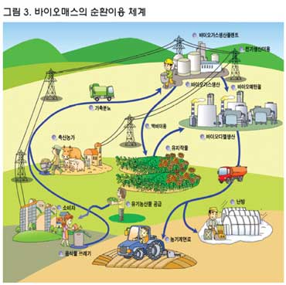
Benefits of small ruminant use in foraging systems and range restoration
In summary, small ruminant species
-> are well suited for range restoration
-> increase the production of livestock biomass in both range and woodland production
systems, particularly when integrated into multispecies grazing systems.
바이오매스 순환체계

Slide 12
Concerns
The effects of animals on the environment
① depend on the intensity of grazing-browsing ② species and/or number of animals
③ type of land (e.g., feedlot, pas-ture, range, woodland, or other type)
④ amount of usable for age
⑤ other husbandry practices connected with livestock production
(e.g., administration of some endectocides (항염증약) or sheep dipping)
Overgrazing, improper grazing management, and intensive production agriculture
① loss of desirable forages ② soil erosion
③ sequestration of soil nutrients in less desirable plants
④ accumulation of toxic chemicals or animal use medicines used in animals' care
Although desirable in weed control, goats' ability to debark plants can be an undesirable trait when they browse on and kill desirable trees.

Slide 13
Concerns
Sound forage and livestock management
① enhance ground cover with crops suitable for grazing
② resist weed or woody plant overgrowth
③ enhance soil fertility and soil water retention
④ minimize the introduction of toxic substances to soils, ground water, and air
-> Emphasis should be placed on production systems (sustainable & environmentally safe)
Major concern : Livestock waste disposal and contamination of air and groundwater
: Misi and Forster (2001) -> gas production associated with small ruminants
-> more work is needed

Slide 14
Concerns
More animal waste products are produced in smaller, confined areas and the reduction of greenhouse gases
-> conflict between modern or improved agricultural practices (Moore et al., 2001).
-> Sheep, goats, cervids, and camelids will all contribute to these production
Yang et al. (2003) : reduction in two greenhouse gases (methane and nitrous oxide) produced by livestock waste management in Taiwan from 1990 to 2000
-> Goat production is a major contributor to livestock waste
: it ranks second to swine production in Taiwan
Much work is required
① determine the exact contribution of small ruminants
② how best to reduce associated emissions worldwide

Slide 15
Concerns
Disposal of livestock waste is a growing concern
-> Improper waste disposal is environmentally damaging.
-> goat : lower organic carbon / higher biodegradable organic compounds
than horse, pig, or rabbit’s manure (Moral et al. (2005))
-> Hutchinson et al. (2005) : E. coli / Salmonella number
consuming forages < grain-fed animals
Thus, low-input, range managed, small-ruminant production
: reduce the potential for transmission of pathogens from manure handling
: reduce the amount of nonbiodegradable livestock waste produced, as compared to other species.

Slide 16
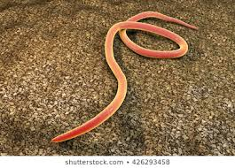
Concerns
Hooda et al. (2000) : keeping small ruminants
① more dispersal of manure ② reduce the need for manure handling
③ reduce parasitism associated with heavy stocking rates of small ruminants
④ dilute any pesticides and antibiotics over greater areas of land
Siddiqui (2004) : composted goat feces (superior to horse manure)
① reducing soilborne nematode growth ② improving tomato growth
However, where handling and disposal of small ruminant manure
: required procedures such as composting, spreading onto large areas, and minimizing water shed contamination
Nematode : 선충

Slide 17
Concerns
High stocking rates, grain diets (e.g., feedlots or dairy), and confinement systems
: require greater future scrutiny -> diminish effects on animal and human health
Growing environmental concern
: soil and water contamination of phosphates, nitrates, and other chemicals from
livestock production
: contribution of these chemicals by sheep, goats, cervids, and camelids
-> minor as compared to other livestock (poultry, swine, cattle) but, also significant
Placing animals on larger range areas vs. small intensely managed areas
: reduces the potential contamination of water sources via simple dilution.
Constantly, moving and grazing sheep on different areas (pastures, woodlands, or rangelands) -> useful for the redistribution of phosphates accumulated in contaminated wetland to other areas or range (Haynes and Williams, 1993).

Slide 18
Concerns
Sheep grazing around North american streams
: no measurable impact on nitrates and phosphates (Darling and Coltharp, 1973).
Ratio of chloride/bromide (useful in the identification/quantification of water contamination)
: lower in leachate from goat waste than in that of domestic wastewater
: within the range of oil field brine (Hudak, 2003).
Some agricultural practices : increase nitrate-N concentrations in underlying groundwater.
-> sheep ranch areas : showed low nitrate-N concentration (McLay et al 2001).
Much research is needed
: better quantify the extent of sheep, goat, cervid, and camelid contribution to this growing concern.

Slide 19
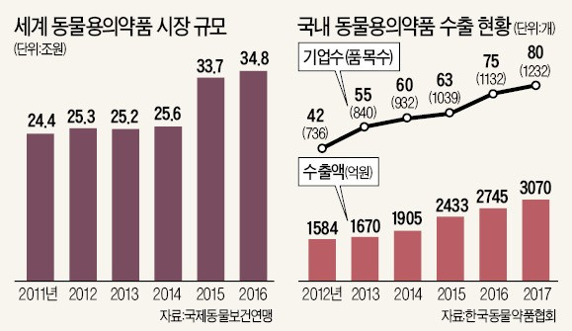
Concerns
Using chemicals and medications : environmental implications
ex) some of the compounds used to control external and internal parasite control, which have garnered much of the concern with respect to potential environmental damage (Virtue and Clayton, 1997; Hooda et al., 2000).
-> Accidental spills, runoff or washoff, urinary and/or fecal excretion, and improper chemical container disposal and/or use.

Slide 20
Concerns
Methods for diminishing contamination from these products have been described (Virtue and Clayton, 1997; Hooda et al., 2000).
ex) Avermectin (endectocides) : chemicals (beneficial effects for animal production)
-> but can result in unwanted altering of the environment
-> toxic effects on terrestrial and aquatic organisms (Bloom and Matheson, 1993).
Avermectins reach the environment : via excretion in feces or other described avenues
-> Population reduction of many beneficial insects (dung beetle etc.)
(Fincher, 1992; Holter et al., 1994; Floate and Gill, 1998; Wardhaugh et al., 2001)
Tannin intake : reduce internal parasitism
-> Using goats and sheep in the control of tannin-rich forages
: decreased need for some endectocides
-> sheep and goats : will diminish the need for many harmaceuticals
reduce potential contamination (Boxal et al. 2003)

Slide 21
Concerns
Spread of disease between domestic small ruminants and wildlife : concern
-> needs to be prevented when ever cograzing occurs
ex) malignant catarrhal fever, pasteurellosis, infectious keratoconjunctivitis and brucellosis
(Meagher et al., 1992 Pugh et al., 1995; Ward et al., 1997; Li et al., 1999, 2003a,b; Rudolph et al., 2003; Kreeger et al., 2004).
Attempts should be made to introduce only healthy animals into range areas where they are to co-graze with wild ruminant species.
: Whenever possible, animals should be quarantined
: Appropriate diagnostic tests utilized : identify any infection in the domestic animals
prior to introduction into the range where they will co-graze with susceptible wildlife
populations.
Whenever co-grazing, domestic creatures are also capable of becoming infected by some diseases from wildlife such as parelaphostrongylosis.

